Slide 1
Introduction of Java
Java is a high-level object-oriented programming language .
Java is a platform-independent.
Java was developed by “Sun Microsystems of USA in 1991”.
James Gosling is the founder of java language.
Old name of java is Oak.
Due to some reason James Gosling and his team change the name Oak to java.

Slide 2
How java Works
Complied
Interpreted
Source Code
Byte Code
Machine Code
javac
java
To compile the program
To Run the Program

Slide 3
Three type of java
Java SE (Standard Edition)
In this Standard edition we can run window or desktop application.
Java EE (Enterprise Edition)
This Edition is used for Web application, it’s a nothing but website
Two type of web
Static website
Dynamic website
Java ME (Micro Edition)
This Edition is used for develop mobile applications.

Slide 4
What is SDLC
SDLC stands for Software Development Life Cycle.
It is a process used by the software industry to design, develop and test high quality software’s.
Seven Stages of SDLC
Problem Definitions.
Analyse and design.
Algorithm
Flowchart
Coding and implementation
Testing and Debugging
Documentation.

Slide 5
Feature of java
Simple
Robust(Strong)
Platform independent
Secured
Portable
Interpreted
High Performance
Multithreaded
Dynamic
Distributed

Slide 6
OOPs
OOPs in java is to improve code readability and reusability by defining a Java program efficiently.
OOPs based on the concept of objects. In object-oriented programming data structures, or objects are defined, each with its own properties or attributes.
Each object can also contain its own procedures or methods.

Slide 7
Five Feature of OOPs
Object and classes
Encapsulation
Abstraction
Inheritance
Polymorphism

Slide 8
Data Types
Two type of data types
Primitive data types:
like Boolean, char, byte, short, int, long, float and double.
Non-primitive data types:
like Classes, Interfaces, and Arrays.

Slide 9
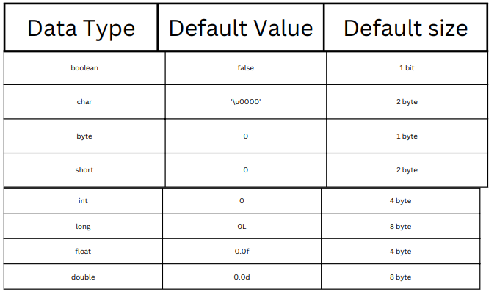
Types of data, Default Value and its size

Slide 10
What is Variable
Variable is a name of memory location. A variable is assigned with a data type.
Types of variables
local variable
A local variable in Java is a variable that's declared within the body of a method.
Instance variable
An instance variable is a variable that is specific to a certain object.
static variable
The static variable can be used to refer to the common property of all objects (which is not unique for each object).

Slide 11
Scanner class
Scanner is a class in java. util package used for obtaining the input of the primitive types like int, double, etc. and strings.
The Scanner class is used to get user input
Methods
nextInt(),
nextByte(),
nextShort(),
next(),
nextDouble(),
nextFloat(),
nextBoolean(),
next().charAt(0)

Slide 12
Java Operators
Java operators are symbols that are used to perform operations on variables and manipulate the values of the operands. Each operator performs specific operations.
Types of Operators
Unary Operators (++,--)
Arithmetic Operators(+,-,*,/,%)
Assignment Operators(=,+=,-=,*=,/=,%=)
Logical Operators(&&,||)
Shift Operators(<<,>>)
Bitwise Operators(&,|,^)
Ternary Operators(<,>,<=,>=,==,!=)

Slide 13
Syntax and Example of Java code
//Sum of two number
//import statements for java program to read inputs using Scanner class
import java.util.Scanner;
class Sample1{
// Main method
public static void main(String args[]){
// Use the scanner class to provide input at execution time using scanner object
Scanner sc = new Scanner(System.in);
System.out.println("Enter first number: ");
int a = sc.nextInt();
System.out.println("Enter second number: ");
int b = sc.nextInt();
int Sum=a+b;
// print the result
System.out.println(sum);
}
}

Slide 14
Thanks

